Slide 1
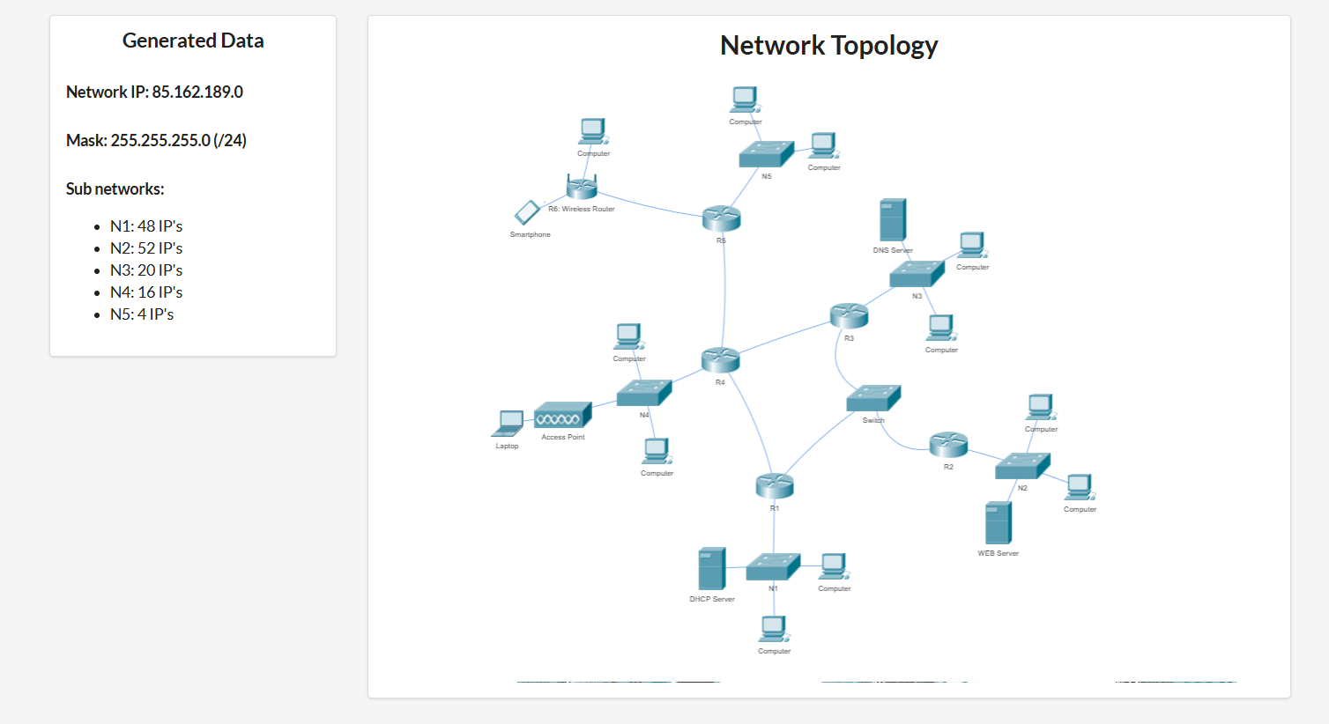
N45
N123
N34
N14

Slide 2
adresa de retea: 85.162.189.0/24 netmask: 255.255.255.0 adresa ip inceput: 85.162.189.1 adresa ip final: 85.162.189.255 Nr IP-uri totale = 256 de IP = 2^8
Adrese IP ramase:
85.162.189.220 --- 85.162.189.255 --- 32
85.162.189.220/30 = 4 IP-uri
85.162.189.224/27 = 32 IP-uri
Retea | Nr IP-uri | Dimensiunea retelei | Adresa de retea | adresa de broadcast
N1 | 48 + 1 + 1 + 1 | 64 | 85.162.189.0/26 | 85.162.189.63
N2 | 52 + 3 | 64 | 85.162.189.64/26 | 85.162.189.127
N3 | 20 + 3 | 32 | 85.162.189.128/27 | 85.162.189.159
N4 | 16 + 3 | 32 | 85.162.189.160/27 | 85.162.189.191
n5 | 4 + 3 | 8 | 85.162.189.192/29 | 85.162.189.199
n123 | 2 + 2 + 2 | 8 | 85.162.189.200/29 | 85.162.189.207
n14 | 2 + 2 | 4 | 85.162.189.208/30 | 85.162.189.211
n34 | 2 + 2 | 4 | 85.162.189.212/30 | 85.162.189.215
nwifi | 2 + 2 | 4 | 85.162.189.216/30 | 85.162.189.219
n45 | 2 + 2 | 4 | 85.162.189.220/30 | 85.162.189.223

